Slide 1
RSVPme: Prototype
Joshua Lorenz, Tyler Johnson, Caleb Horn, Fugang Deng, Chen Zhang

Slide 2
RSVPme Overview
Real life event organization
Private events
Put together by friends
Birthday parties and going out to eat
Public events
Put together by organizations and businesses
Paid feature
Additional functionality
Extended group chat functionality
Football games and concerts
Notes:
First, let us quickly overview the project again. We are creating a social media called RSVPme. This social media is built around creating and finding real life events. This is divided into two main groups, private and public events. Private events would be those which are organized and put together by a group of friends. Examples of this could be birthday parties and going out to eat togher. On the other hand, public events are hosted by organizations or businesses and are able to be found by anyone. We expect that creating public events will be a paid feature which also include additional functionallitys such as a more robust group chat system to more properly handle larger groups of attendees. Examples of these types of events would be football games and concerts.

Slide 3



Implementation Overview
Divided the project based on interest and preference
Used the agile methodology to create and reach specific goals for this project.
Current stage was developed mainly by Lex
Has the most experience
Removes confusion of multiple people working on a small project
Gives a strong foundation to work off of
Current tools we have used include
React Native
MongoDB
Google Maps API

Slide 4
Current Progress
- add event (to server)
- delete event (from server)
- display events (fetch events from server)
- display event's location on map
- add friend by ID
- remove friend by ID

Slide 5
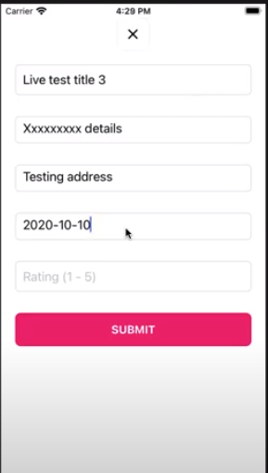
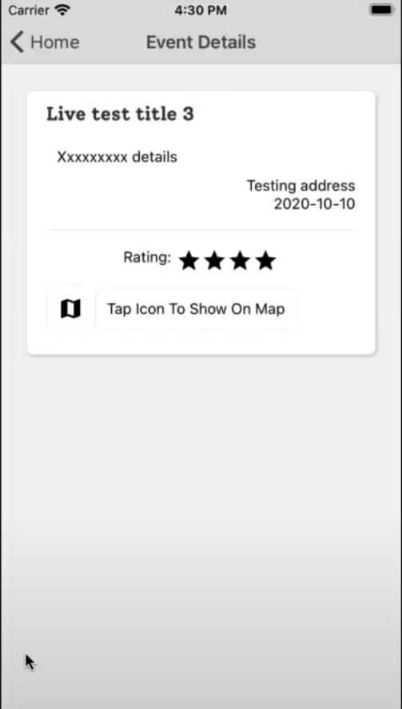
Implemented Functionalities
Create event

Slide 6
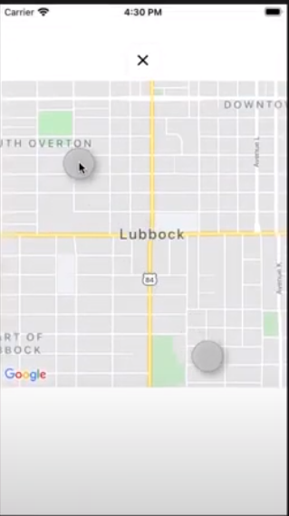
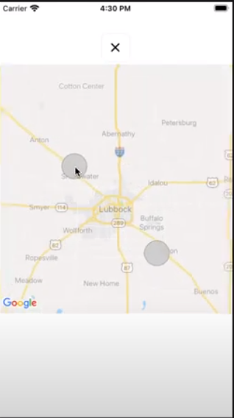
Implemented Functionalities
Google maps navigation

Slide 7
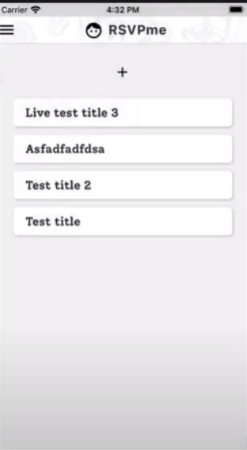
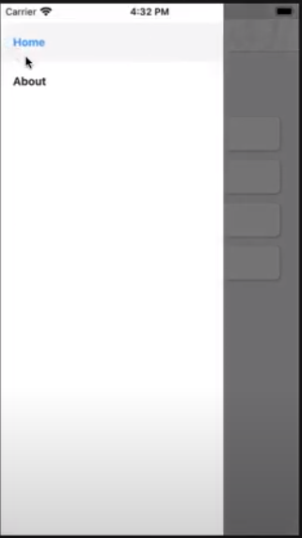
Implemented Functionalities
Menu

Slide 8
Functionalities in progress
Delete event
Pins on the map
User Authentication

Slide 9
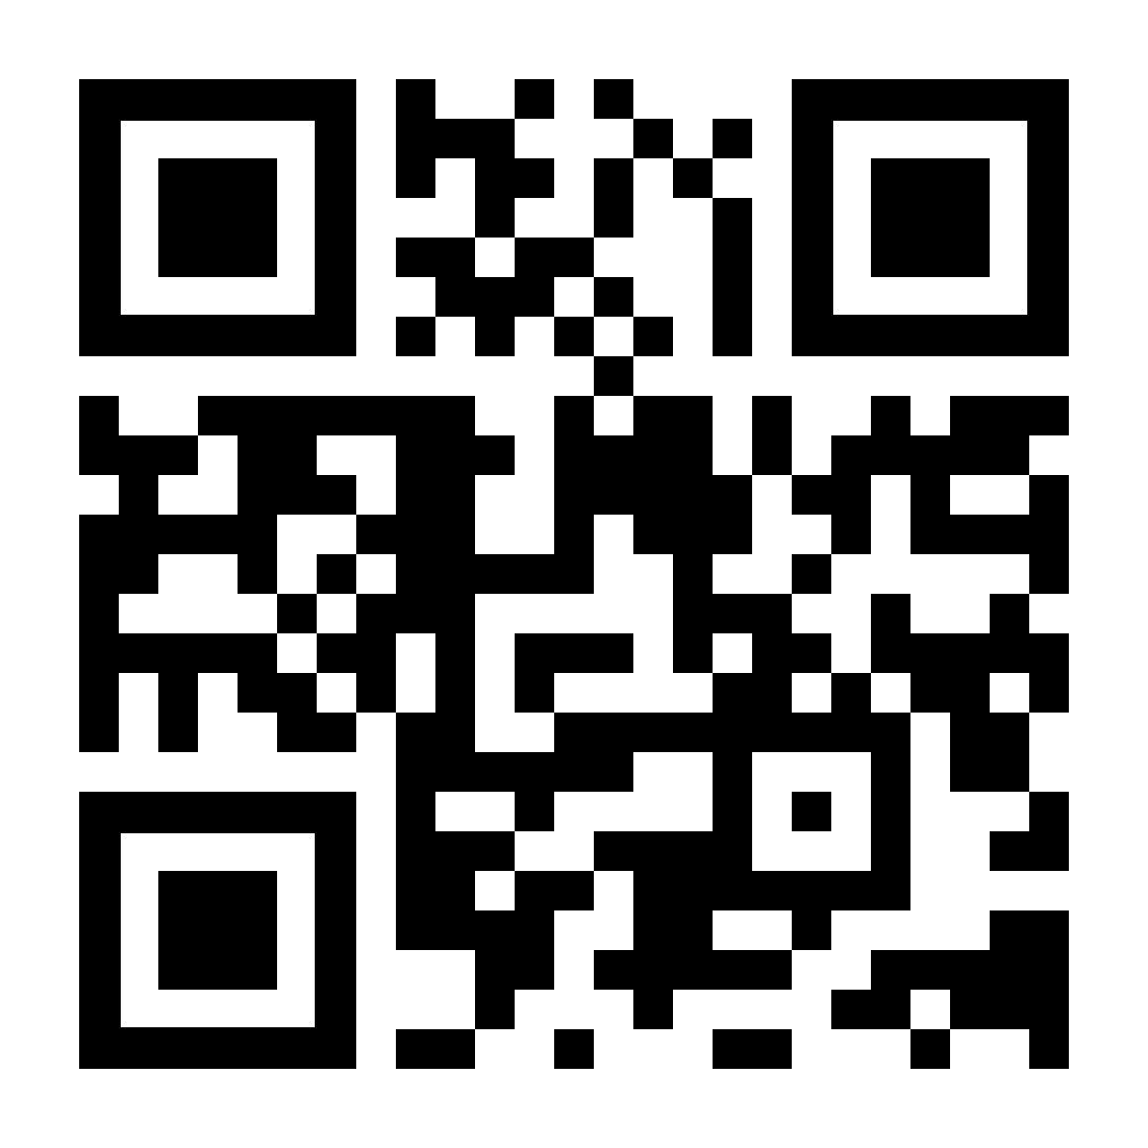
Remaining Functionality
QR-codes
Group Messaging

Slide 10
Implementation Issues
Event creation working well with google maps.
Snapshot of map below the event during creation.
Pins on the map.
Map is clunky to use.
Overhaul UI.

Slide 11
Member Contributions
Caleb:
Will implement the calendar functionality, as well as figure out how to do the group messaging system, and help with UI implementation/cleanup.
Lex:
Did most of the prototype, laid the groundwork for future implementation in the front and backend.
Tyler:
Will work on OAuth, google maps frontend, and cleaning up ui.
Josh:
Will help with the group messaging system and implementing QR-code generating/reading.
James:
Will implement notifications.

